Slide 1
Video editor use case analysis and optimization scheme discussions
Feng Wei, Gu Wangyi
WW11’2012

Slide 2
Team Internal Use Only

Slide 3
Agenda
Video Editor Introduction
Software Stack Overview
Control and Data Flow Analysis
Optimization Scheme Discussion

Slide 4
Agenda
Video Editor Introduction
Software Stack Overview
Control and Data Flow Analysis
Optimization Scheme Discussion

Slide 5
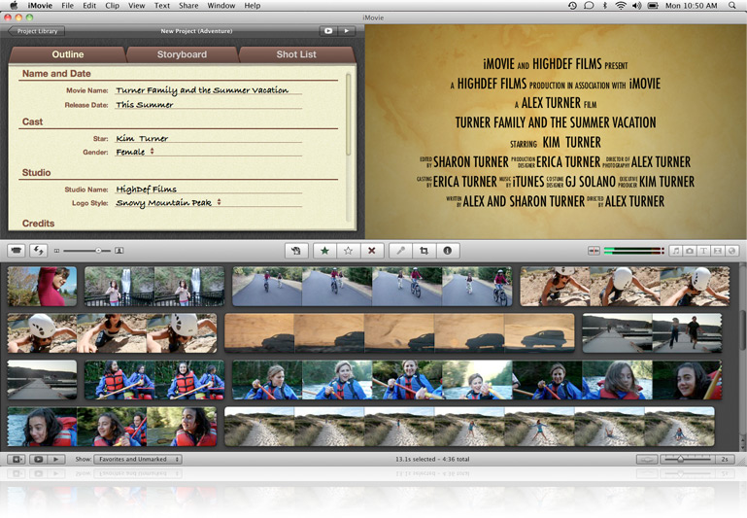
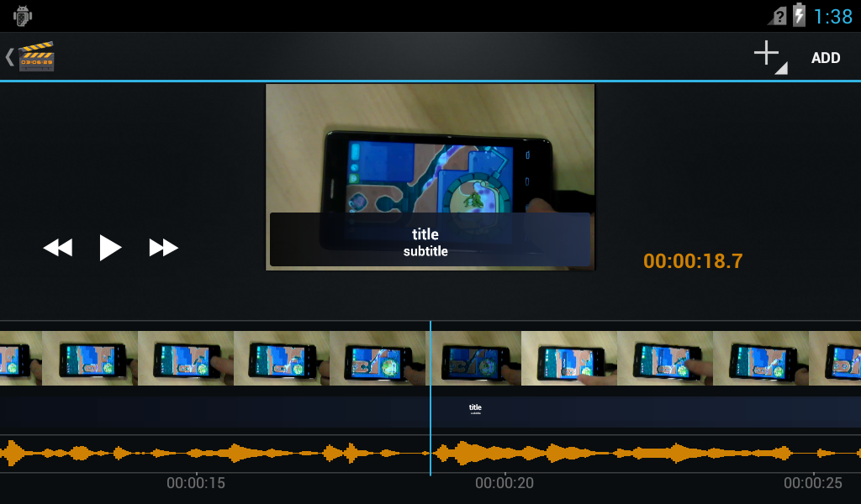
Video Editor Introduction
To compete with iMovie (running on iMac, iPad and iPhone)
First released in Android Honeycomb for Tablets (2011.2)
Brought to mobile phones in ICS.
iMovie
Movie Studio

Slide 6
Use Cases and Capabilities
Video Processing
Color Effects: gradient, sepia, negative, pan-zoom (picture only)
Logo Overlay: title and substitute
Resize: up-scaling and down-scaling
Video Joint and Cut
Joint: several video clips into one
Transition: crossfade, alpha blending, fade black, sliding
Change aspect ratio
Cut: begin and end time

Slide 7
GUI
Preview Window
Thumbnail Window
Title Window
Waveform Window

Slide 8
Agenda
Video Editor Introduction
Software Stack Overview
Control and Data Flow Analysis
Optimization Scheme Discussion

Slide 9
Software Stack Overview
Moorestown
Medfield
Apps and middleware
Video Editor Application
Android
Java FW
android.media.videoeditor
android.view.surface
…
Video Editor Service
Android
Native FW
Stagefright Media Framework
Surface Flinger
OpenMAX IL Components
Audio Flinger
User Space
Video MW Lib (MI-X)
ALSA
Misc/IPP
LibVA Video Library
MSIC Devices
Kernel Space
Video Decode Driver
Video Encode Driver
Gfx Drv
Audio Driver
Display Driver
Drivers/
FW/ HW
HW
HW Video
Decoder
HW Video
Encoder
Graphics
Engine
Tensilica
Audio Engine
Display Controller
Notes:
9

Slide 10
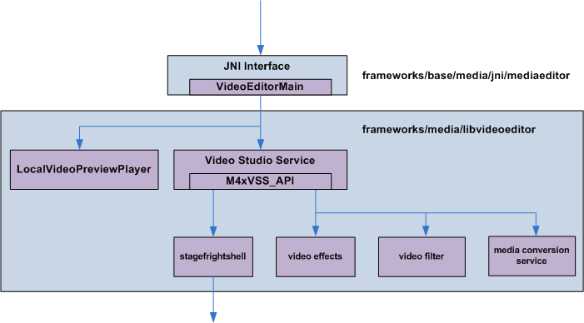
Video Editor Native Stack

Slide 11
Agenda
Video Editor Introduction
Software Stack Overview
Control and Data Flow Analysis
Optimization Scheme Discussion

Slide 12
Typical Scenarios
Effect Preview
Color Effects: gradient, sepia, negative, pan-zoom
Logo Overlay: title and substitute
Resize: up-scaling and down-scaling
Joint: several video clips into one
Change aspect ratio
Cut: begin and end time
Clip Generation
Movie export
Transition
Pan-zoom effect for pictures

Slide 13
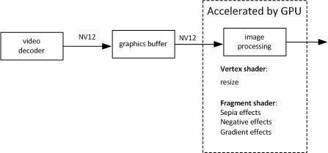
Effect Preview

Slide 14
Effect Preview
VE Preview Controller
bitstream
decode
render
VE Video Decoder
OPEN GL ES Library
read
Stagefright
dequeue
NativeWindow
SurfaceFlinger
filloutputbuffer
queue
OMX IL
backbuffer
frontbuffer
Graphic buffer
queue
decode
LibMIX
LibVA
decode into

Slide 15
Clip Generation

Slide 16
Clip Generation
bitstream
bitstream
VE Video Decoder
decode
VE Video Processing
process
VE Video Encoder
render
read
read
resize
effect
color convert
Stagefright
copy
Stagefright
color convert
filloutputbuffer
draininputbuffer
OMX IL
OMX IL
decode
encode
LibMIX
LibMIX
copy
copy
LibVA
LibVA

